Slide 1

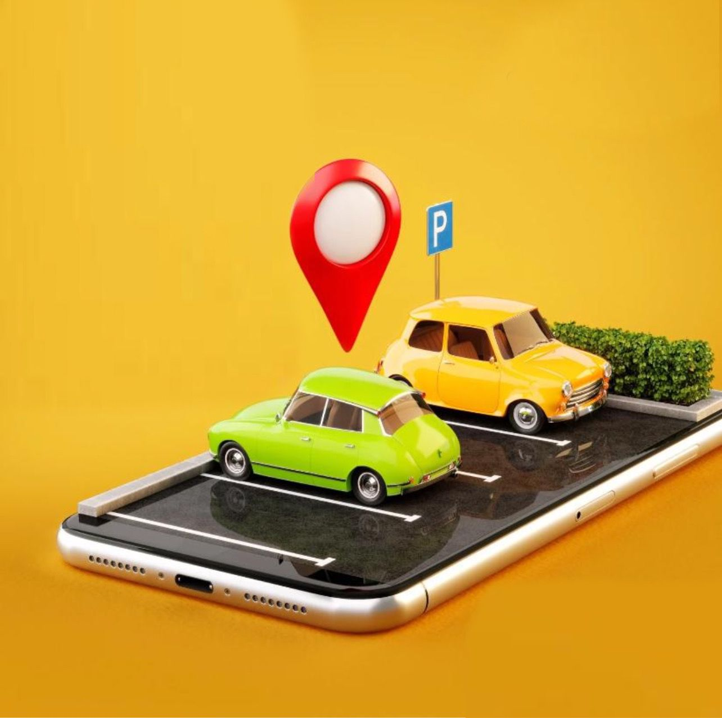
ParkNow
Amar Diab
Samar Khalil

Slide 2

Agenda
Problem
Existing Solutions
Our solution
Challenges
Tools
UML Diagrams
GUI
Testing
Constraints
Conclusion

Slide 3

Problem & Existing Solutions

Slide 4
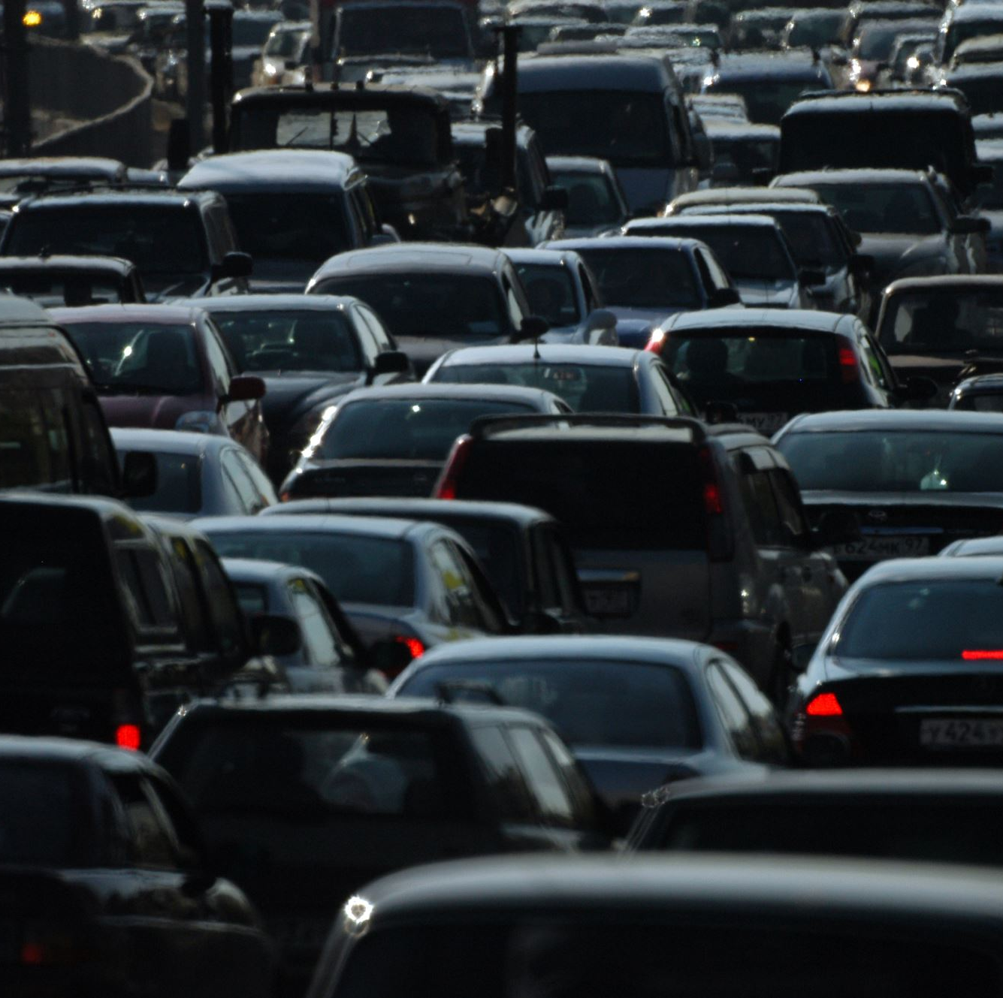
Problem Statement
More Cars, Less Space
Hard to Find Parking
Traffic Jams
More Pollution
Frustrated Drivers

Slide 5
Existing solutions
1. iPark
Advantages of iPark:
Advance Reservations
Variety of Parking Locations
Disadvantages of iPark:
Limited Real-Time Updates
Geographic Limitations
Real-Time Availability
Scalability and Adaptability
Improved User Interface
How Our Project is Better:

Slide 6
Existing solutions
2. SpotHero
Advantages of iPark:
Advance Reservations
Disadvantages of iPark:
Static Data
Discounted Rates
Limited Coverage
Real-Time Monitoring
Environmental Impact
Increased Reliability
How Our Project is Better:

Slide 7

Our solution - ParkNow
Advanced Parking Management System: Leverages IoT sensors, cameras, and machine learning to provide real-time updates on parking availability.
User-Friendly Mobile Application: Enables users to easily find, reserve, and pay for parking, ensuring a seamless experience.
Scalable and Adaptable: Designed to be suitable for both public and private parking areas in various urban settings.

Slide 8
Challenges
Ensuring Real-Time Data Accuracy.
Optimizing Sensor and Camera Placement.
Integrating Secure Payment Systems.
Maintaining User Data Privacy.
Handling High Data Processing Requirements.
GPS Unreliability Due to War Conditions in Israel

Slide 9

Tools

Slide 10
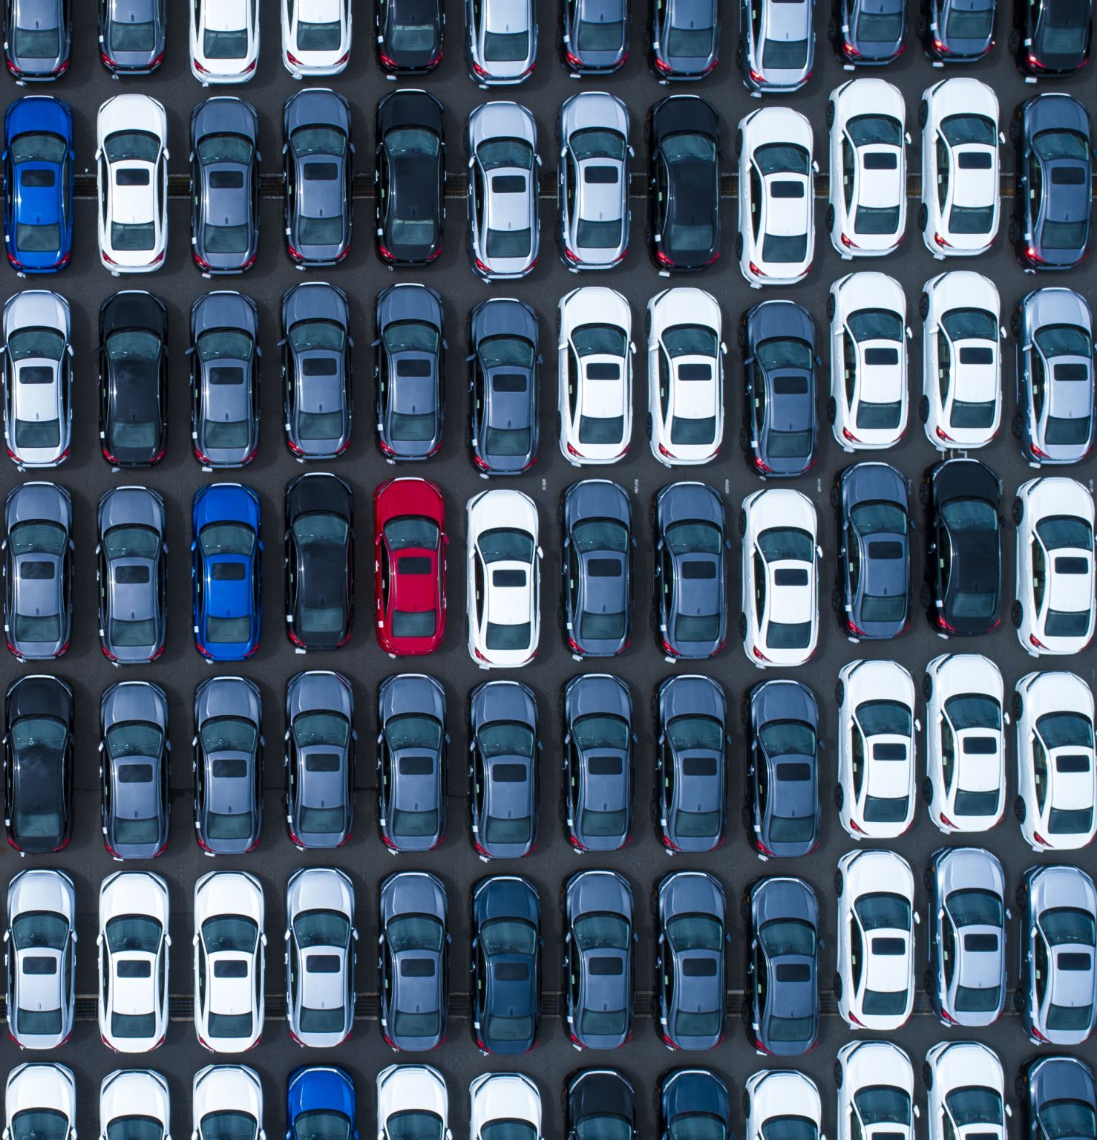
YOLO (You Only Look Once):
Real-Time Object Detection:
YOLO efficiently detects available parking spots using live camera feeds.
Instant Updates:
It ensures users receive up-to-the-minute information on parking availability.
Enhanced Accuracy:
YOLO improves detection reliability in various conditions, making our system more dependable.

Slide 11
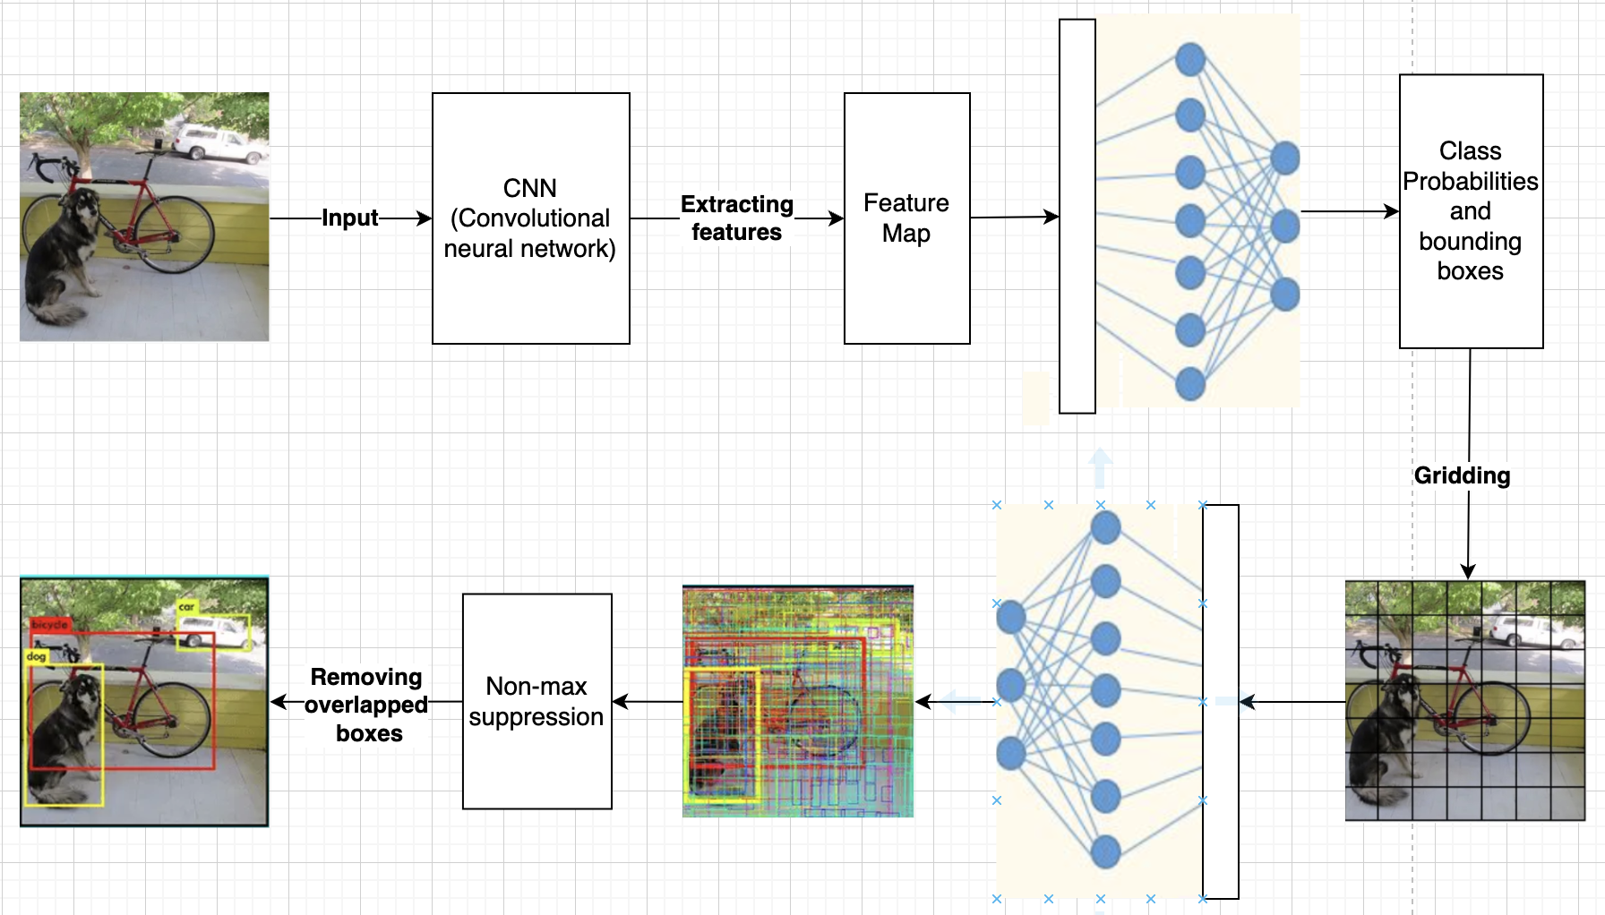
How does YOLO work?

Slide 12
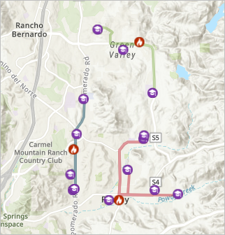
ArcGIS
Geospatial Analysis
Integration with Sensors
Optimized Parking Solutions

Slide 13

How does ArcGIS work?
Data Collection
Data Management
Spatial Analysis
Visualization
Real-Time Updates

Slide 14

UML Diagrams

Slide 15
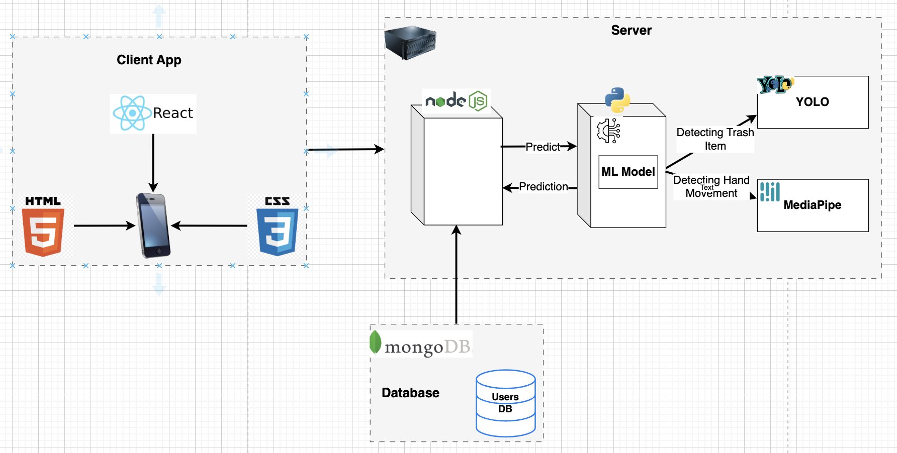
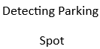
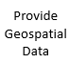

Architecture Diagram

Slide 16
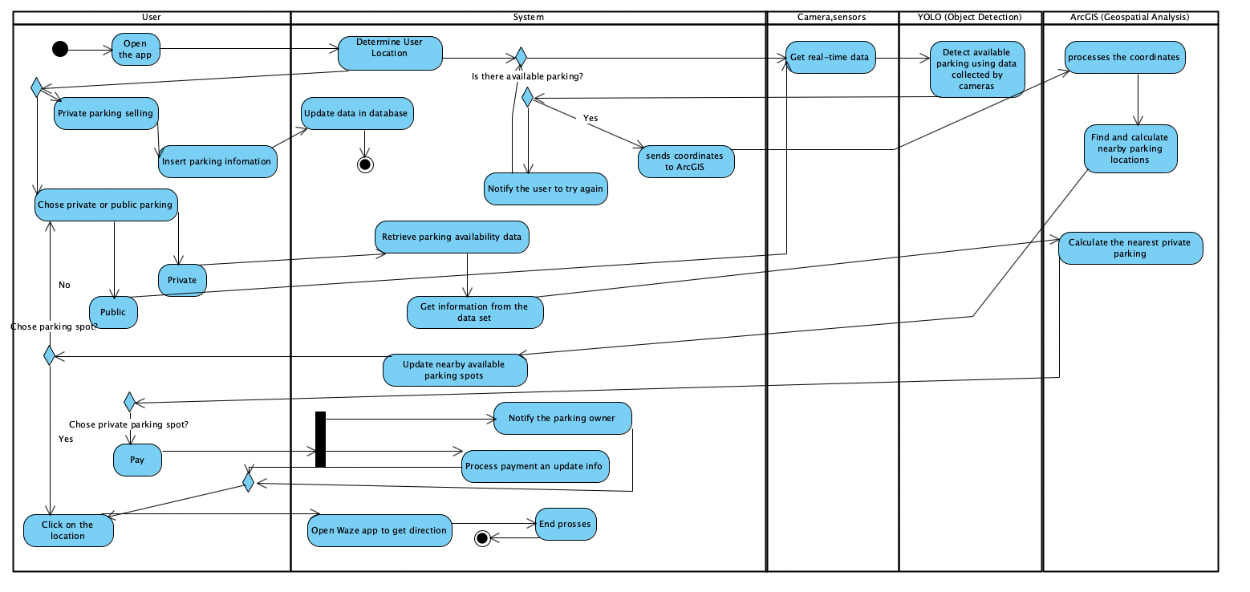
Activity Diagram

Slide 17
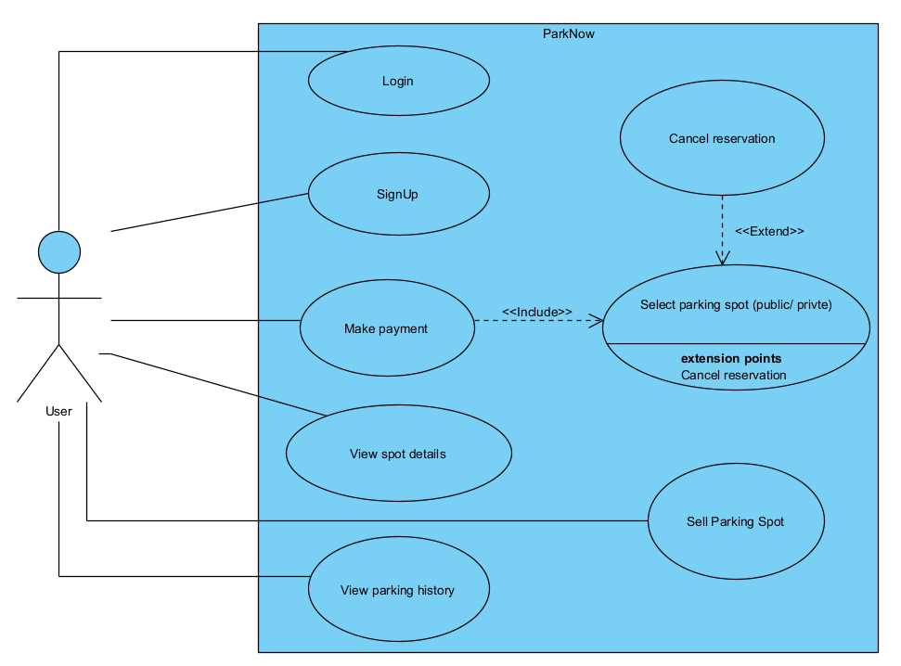
Use Case Diagram

Slide 18

GUI

Slide 19

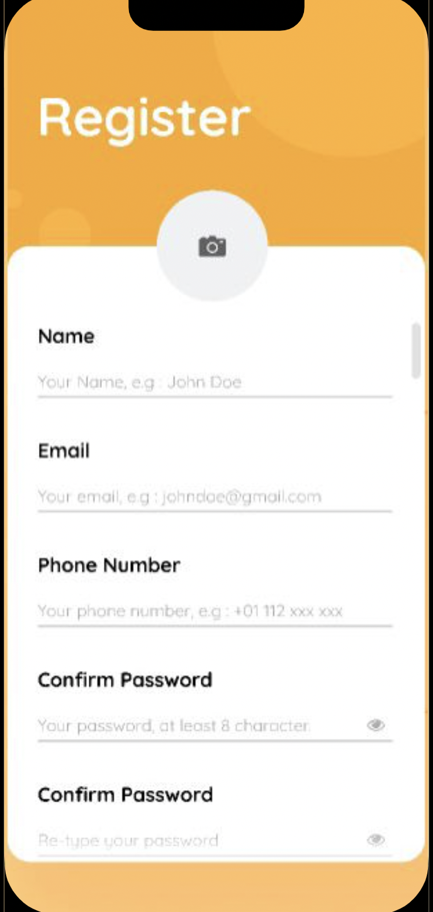
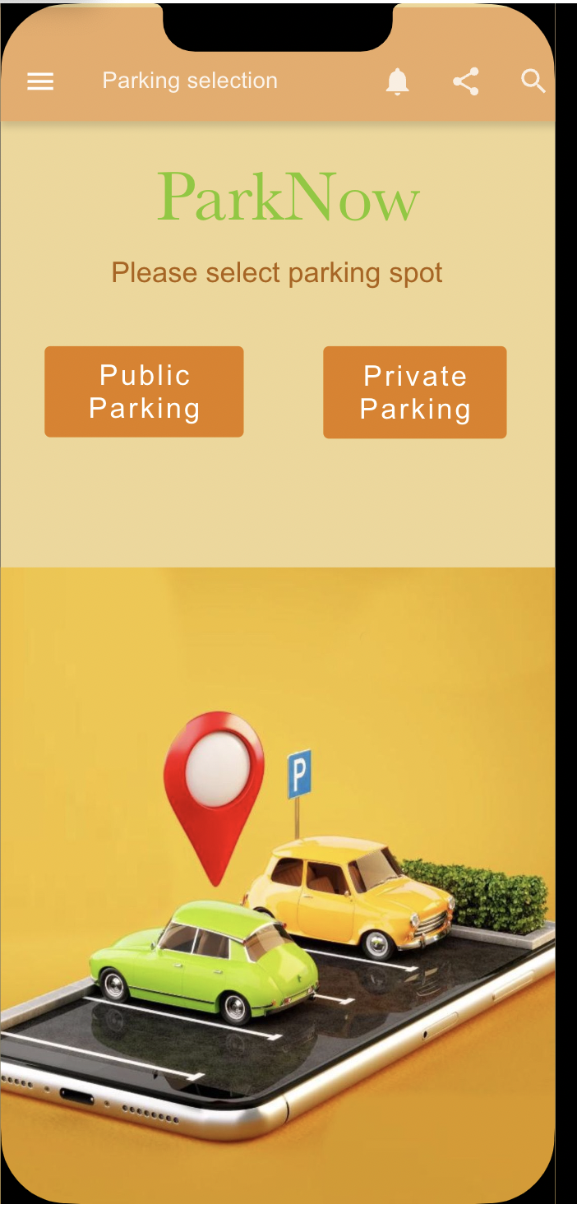

Slide 20
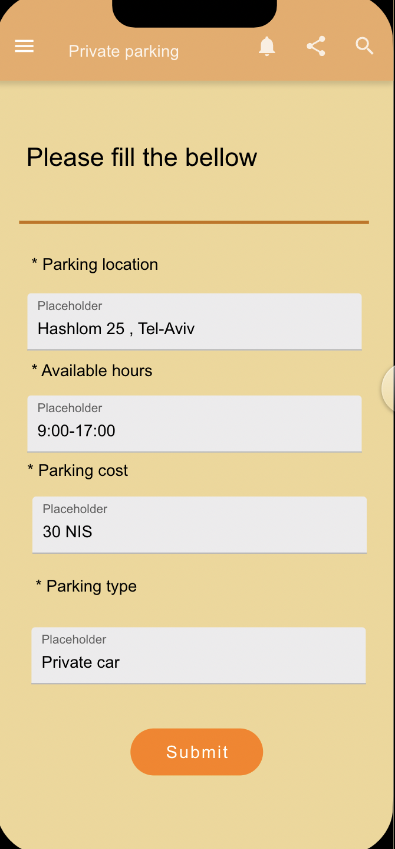
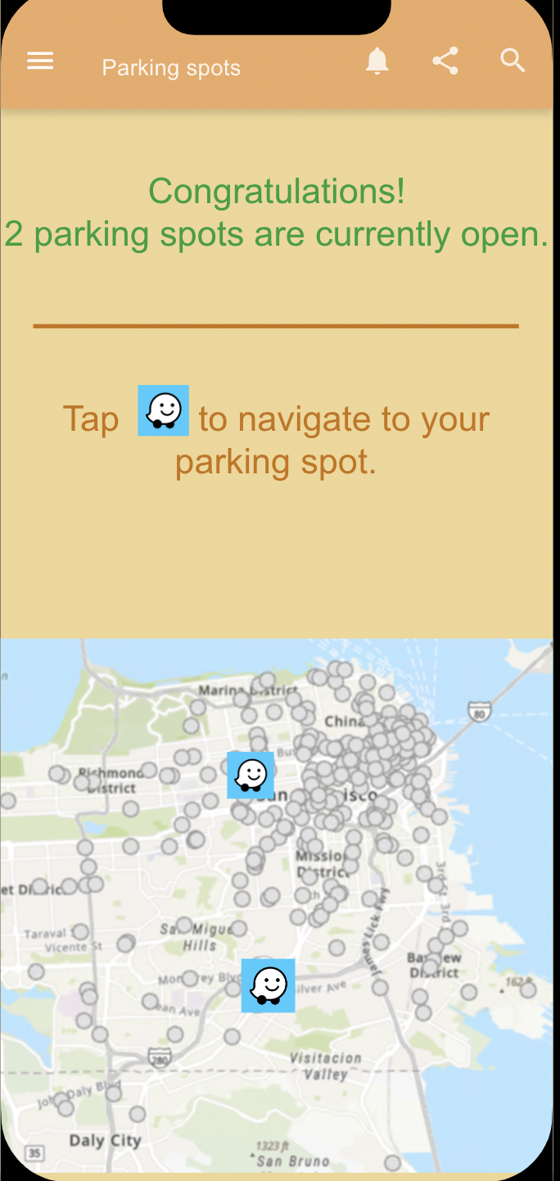
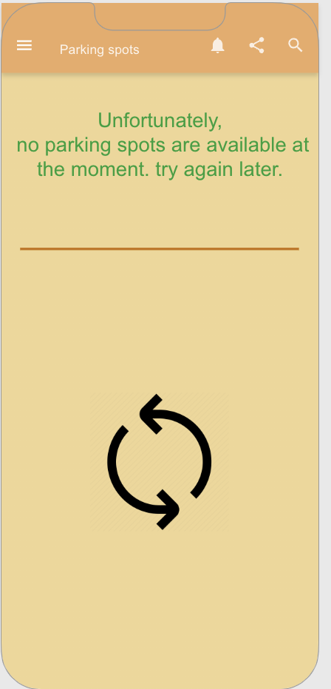

Slide 21


Slide 22
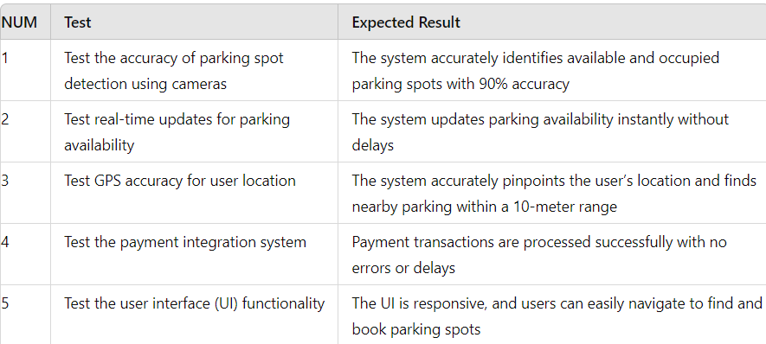
Testing

Slide 23

Environmental Factors
Variations in lighting conditions, weather, and background clutter may impact the accuracy of parking spot detection.
Network Reliability
Dependence on stable internet connections for real-time data processing and updates. Poor network conditions could lead to delays or inaccuracies in parking availability information.
Constraints

Slide 24
conclusion
Transforming Urban Parking:
Our Smart Parking System is a major step forward in urban mobility, streamlining the parking process and reducing stress for drivers.
Leveraging Advanced Technologies:
With the integration of IoT sensors, real-time data processing, and machine learning, we deliver precise and timely parking availability updates.
Enhancing User Experience:
Beyond saving time, our system helps lower traffic congestion and reduce emissions, contributing to a more sustainable and efficient urban environment.
24

Slide 25


